Slide 1
Clustering Web Images by Entity Disambiguation
Kaiqi Zhao, Qingyu Sui, Enxun Wei, Zhiyuan Cai and Kenny Q. Zhu

Slide 2
Outlines
Motivation of web image clustering
Image clustering techniques
TSC-V Framework
Evaluation
Demo

Slide 3
Outlines
Motivation of web image clustering
Image clustering techniques
TSC-V Framework
Evaluation
Demo

Slide 4
Motivation
Google image search for “bean”:
Fig 1. Screen shot of Google Image result

Slide 5
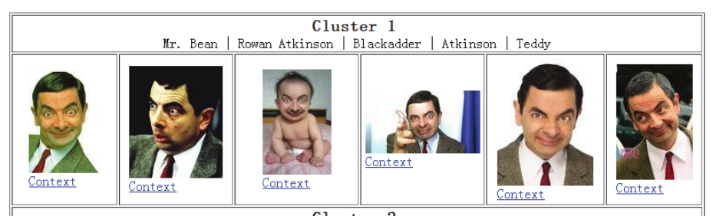
Motivation
Clustered image search result for “bean”:
Fig 2. Screen shot of our prototype system

Slide 6
Outlines
Motivation of web image clustering
Image clustering techniques
TSC-V Framework
Evaluation
Demo

Slide 7
Image clustering techniques
Content-based
Local visual features:
SIFT, edge histogram, etc.
Global visual features:
Color histogram, contrast, gray scale, brightness, etc.
Context-based
IGroup, using search snippets and Bag of words model
Hybrid
Multi-modal constraint propagation, using modals of textual and visual graphs.

Slide 8
Image clustering techniques
Problems in these techniques:
Unreliability of visual features
Ambiguity of word/phrases in the context
Semantic gap between textual and visual features
Fig 1. Screen shot of Google Image result

Slide 9
Outlines
Motivation of web image clustering
Image clustering techniques
TSC-V Framework
Evaluation
Demo

Slide 10
Framework
Image Clusters
Images with original webpages
Combining visual features
Tri-stage cluster
Meta Context Extraction
Context expansion
Wikipedia
Clustering by text context
Conceptualization
Clustering by metadata
Conceptualized meta context
Conceptualized webpages
Query
Text context extraction
Offline
Online
Fig 3. TSC-V Image Clustering Framework

Slide 11
Framework – Context Extraction
Meta context
Anchor text
Text in “ALT” attributes of <IMG> tag
URL
http://domain.com/53C316-C2oJ5/AppleInc_2012.jpg
AppleInc, 2012
Split to words
Detect random strings using a two-class classifier

Slide 12
Framework – Context Extraction
Text context
Image context
Query context
Extract text within 100 words before and after as text context
Fig 4. Image Context & Text Context

Slide 13
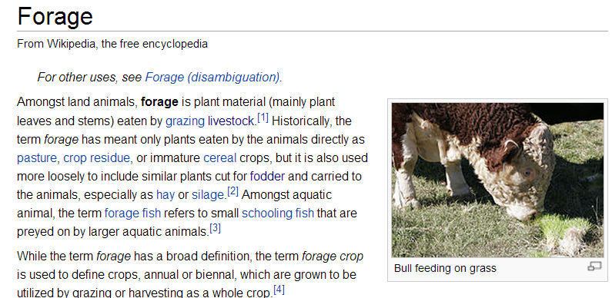
Framework – Conceptualization
Plain text to Wikipedia concepts - Wikification
Bean
Bean Kent
Mr. Bean
……
Plant
Physical plant
Plant (snooker)
……
Forage
Data feed
Feed (film)
……
Bean is a common name for large plant seeds used for human food or animal feed of several genera of the family Fabaceae.
Bean[Bean] is a common name
[Common name] for large plant[Plant] seeds[Seed] used for human food[Food] or animal feed[Forage]
of several genera[Genus] of the family[Family] Fabaceae[Fabaceae].
Fig 5. Wikipedia article of “Forage”

Slide 14
Framework – Conceptualization
Co-occurrence information in Wikipedia
Article title and links
Links and links in a window
Sliding Window
Demo site of Wikification: http://202.120.38.145:4082/wvc
Bean is a common name for large plant seeds used for human food.
<Bean, 15> <Common name, 15> <Plant, 15>
<Common name, 18> <PLANT, 18> <Mobile Suit Gundam SEED, 18>
<Plant, 23> <Seed, 23> <Food, 23>
<PLANT, 18>
<Mobile Suit Gundam SEED, 18>
<Plant, 38>
<Seed, 23>
Bean[Bean] is a common name[Common name] for large plant[Plant] seed[Seed]s used for human food[Food].

Slide 15
Framework
Image Clusters
Images with original webpages
Combining visual features
Tri-stage cluster
Meta Context Extraction
Context expansion
Wikipedia
Clustering by text context
Conceptualization
Clustering by metadata
Conceptualized meta context
Conceptualized webpages
Query
Text context extraction
Offline
Online
Fig 3. TSC-V Image Clustering Framework

Slide 16
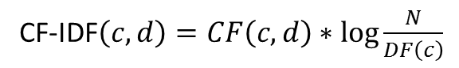
Framework – Image Clustering
Context representation
Concept vector space
CF-IDF
CF-IDF$\left(c, d\right)=CF\left(c, d\right)∗\log{\frac{N}{DF\left(c\right)}}$
# of Wikipedia articles
Concept frequency of c in the context d
Document frequency of c in the whole Wikipedia corpus

Slide 17
Framework – Image Clustering
Hierarchical Agglomerative Clustering (HAC)
Input: similarity between data points
Output: clustering hierarchy
Similarity
threshold
Image1
Image2
Image3
Image4
Image5
Image6
Fig 6. Example of HAC

Slide 18
Framework – Image Clustering
HAC with Cluster Conceptualization (HAC_CC)
Tradition cluster similarity:
Single-link, Complete-link, Centroid, Group Average
Cluster similarity based on conceptualization
Added up all the concept vectors in the cluster
Keep top 50 concepts ranked by CF-IDF for each cluster
Compute the cosine similarity based on the cluster concept vector

Slide 19
Framework – Image Clustering
Tri-stage clustering on textual features
Stage 1: Clustering on meta context
Intuition: Signals from meta data are most related
Method:
Build concept vector for each image from meta context
Clustering using HAC_CC
Stage 2: Clustering on text context
Stage 3: Clustering with concept expansion

Slide 20
Framework – Image Clustering
Tri-stage clustering on textual features
Stage 1: Clustering on meta context
Stage 2: Clustering on text context
Intuition: Surrounding text also provide signals but less reliable
Method:
Rebuild concept vector for each image on text context
Add up new concept vectors in each cluster to reconstruct cluster vectors
Clustering using HAC_CC
Stage 3: Clustering with concept expansion

Slide 21
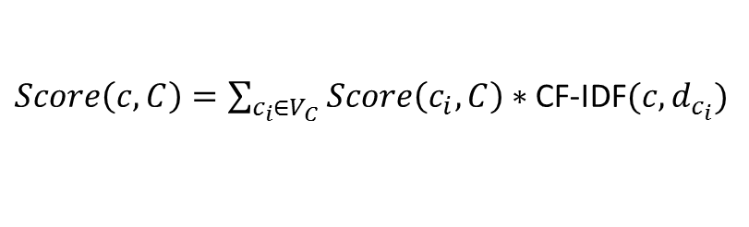
Framework – Image Clustering
Tri-stage clustering on textual features
Stage 1: Clustering on meta context
Stage 2: Clustering on text context
Stage 3: Clustering with concept expansion
Intuition: External knowledge bring more signals
Method:
Replace each concept in a cluster concept vector by the links in the article of the concept
New concept vector for a cluster is constructed:
Clustering using HAC_CC
$Score\left(c, C\right)=\sum_{c_{i}∈V_{C}}{Score\left(c_{i}, C\right)∗ }$CF-IDF$(c, d_{c_{i}})$

Slide 22
Framework – Image Clustering
Incorporating visual features
Intuition: lack of textual signals, merge outlier clusters
Input: visual similarity matrix, tri-stage clustering result
Output: final clusters
Method:
Image1
Image1
Image2
Image2
Image3
Image3
Image4
Image4
Image5
Image5
Image7
Image6
Image6
Image8
Image9
a) Merge
b) Don’t merge
Fig 7. Example of Incorporating visual features

Slide 23
Outlines
Motivation of web image clustering
Image clustering techniques
TSC-V Framework
Evaluation
Demo

Slide 24
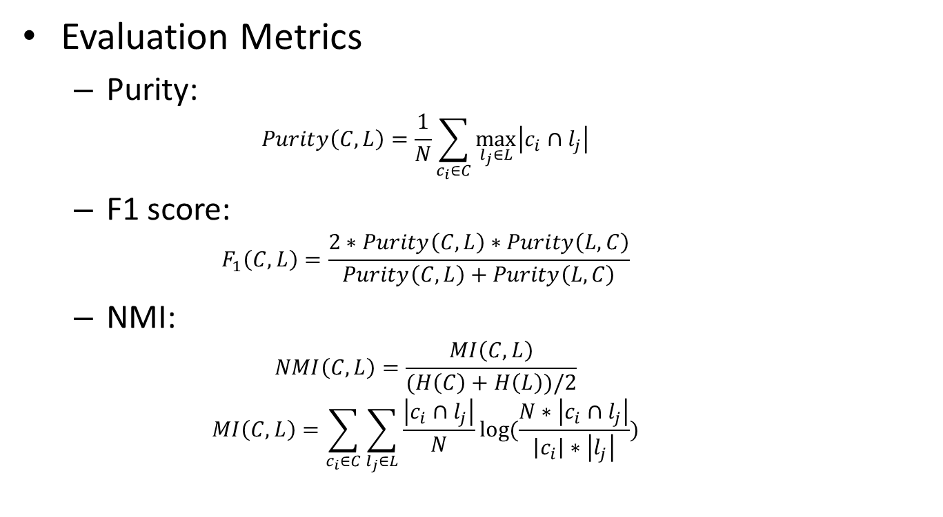
Evaluation
Evaluation Metrics
Purity:
$$Purity\left(C,L\right)=\frac{1}{N}\sum_{c_{i}∈C}{\max_{l_{j}∈L}\left|c_{i}∩l_{j}\right|}$$
F1 score:
$$F_{1}\left(C,L\right)=\frac{2∗Purity\left(C,L\right)∗Purity\left(L,C\right)}{Purity\left(C,L\right)+Purity\left(L,C\right)}$$
NMI:
$$NMI\left(C,L\right)=\frac{MI\left(C,L\right)}{(H\left(C\right)+H\left(L\right))/2}$$
$$MI\left(C,L\right)=\sum_{c_{i}∈C}{\sum_{l_{j}∈L}{\frac{\left|c_{i}∩l_{j}\right|}{N}log⁡(\frac{N∗\left|c_{i}∩l_{j}\right|}{\left|c_{i}\right|∗\left|l_{j}\right|})}}$$

Slide 25
Evaluation
Context extraction:
Context representation:
Context | Purity | F1 | NMI
Whole page | 0.71 | 0.79 | 0.30
Image | 0.92 | 0.85 | 0.62
Image + Query | 0.92 | 0.86 | 0.64
Representation | Purity | F1 | NMI
Bag of words | 0.93 | 0.58 | 0.46
Bag of phrases | 0.96 | 0.62 | 0.46
Concept vector | 0.95 | 0.78 | 0.58

Slide 26
Evaluation
Clustering algorithm:
Algorithm | Purity | F1 | NMI
AP | 0.92 | 0.58 | 0.49
AP + Expansion | 0.89 | 0.59 | 0.47
HAC_CC | 0.95 | 0.78 | 0.58
HAC_CC + Expansion | 0.92 | 0.82 | 0.59
TSC | 0.92 | 0.86 | 0.64
TSC-V | 0.90 | 0.87 | 0.65

Slide 27
Evaluation
Peers:
IGroup
VIPS based (Cai)
Multi Modal Constrants Propagation
BOW with HAC_CC
 | IGroup | Cai | MMCP | BOW | TSC-V
Purity | 0.61 | 0.63 | 0.71 | 0.93 | 0.90
F1 | 0.71 | 0.72 | 0.60 | 0.58 | 0.87
NMI | 0.13 | 0.09 | 0.26 | 0.46 | 0.65

Slide 28
Evaluation
Efficiency:
Time cost of clustering 100 images (ms)
IGroup | Cai | MMCP | TSC | TSC-V
441 | 114 | 5021 | 1121 | 1139

Slide 29
Outlines
Motivation of web image clustering
Image clustering techniques
TSC-V Framework
Evaluation
Demo

Slide 30
Demo
Demo web site:
http://202.120.38.145:4081/

Slide 31
Thank you for attention ☺

